Slide 1

Logical and Arithmetical Operations on Images
Mikołaj Leszczuk, Andrzej Matiolański
Notes:
The Matlab icon indicates which operations you can (and will) perform with Matlab.

Slide 2
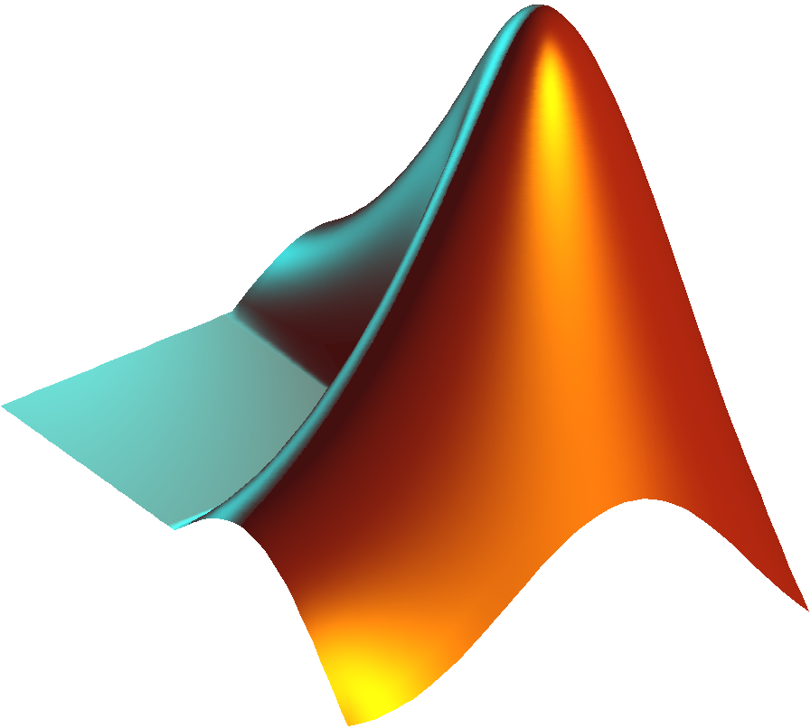
Class Description
Logical operations on images:
AND
OR
XOR
NEGATIVE
Threshold
Arithmetical operations on images:
Weighted sum/convolution
Basics of background modelling (subtraction)/foreground detection

Slide 3
Logical Operations on Images

Slide 4
Bit Block Transfer (Bit Blit)
Computer graphics operation in which several bitmaps are combined into 1 using Boolean function
Operation involving 2+ bitmaps:
Source
Destination,
Mask (possibly)
Stencil (sometimes)
Pixels of each combined bitwise according to a specified raster operation (ROP)
Result then written to the destination
ROP – essentially Boolean formula
Most obvious ROP overwriting destination with source
Other ROPs may involve:
AND
OR
XOR
NOT
Notes:
In general, this technique is not used anymore (its first implementation comes from 1975). You can find it in Comodore’s Amiga (old computer; 1985).
We show it to present something simple. which also has a historical meaning.

Slide 5





Basic Logical Operations
a
b
NOT(a)
a . b
Black pixels represent binary 0 (false state)
a + b
Notes:
Black - logical zero (false state)
White - logical one (true state)

Slide 6

Image Masks (1/2)
When a given image is intended to be placed over a background, transparent areas can be specified with a binary mask
This way, for each intended image – 2 bitmaps are needed:
Original image, in which unused areas have pixel value set to 0 (all channels)
Additional mask, in which:
Areas where the original image is to be placed have all pixels set to 0 (all channels)
Surrounding areas have all pixels set to 1 (all channels)
In sample at right:
Black pixels having all-0 bits
White pixels having all-1 bits
Notes:
I say “all channels” because colour images have usually 3 channels per pixel. in other words, there are 3 values given for each pixel.

Slide 7
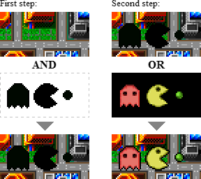
Image Masks (2/2)
To put an image over a background:
Mask background pixels with an image mask at desired coordinates using bitwise AND operation:
Preserve background pixels of transparent areas (white pixels)
Set to 0 all pixels to be obscured by the overlapped image
Render the selected image pixels by combining them with background pixels using bitwise OR operation:
Image pixels must be appropriately placed
Rendering keeps surrounding pixels of the background preserved
Result: a perfect compound of the image and the background

Slide 8
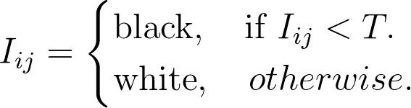
Thresholding
The simplest method of image segmentation
A grayscale image can be converted into binary one
Simplest thresholding methods – replace each pixel in image with:
Black pixel if image intensity I_{ij} (in i-th row and j-th column) less than some fixed constant T
White pixel if image intensity greater than that constant
Notes:
What value does “white” correspond to depends on the colour space used (e.g., 1 channel described with 8 bits -> 255)

Slide 9
Thresholding
An exemplary image on next slide – resulting in:
Darker regions becoming completely black
Lighter regions becoming completely white

Slide 10
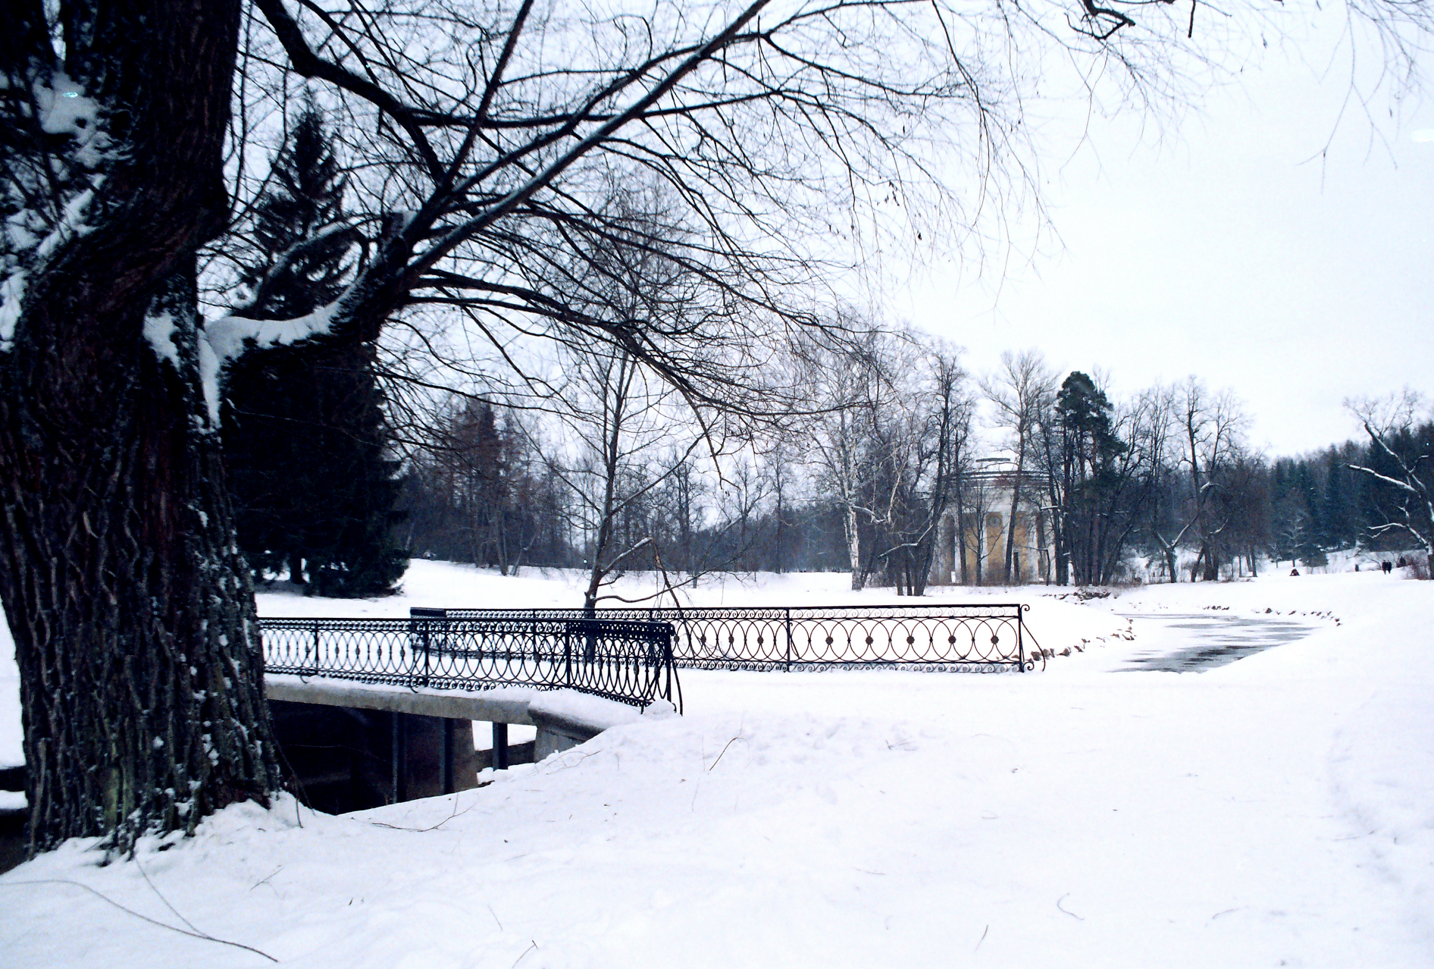
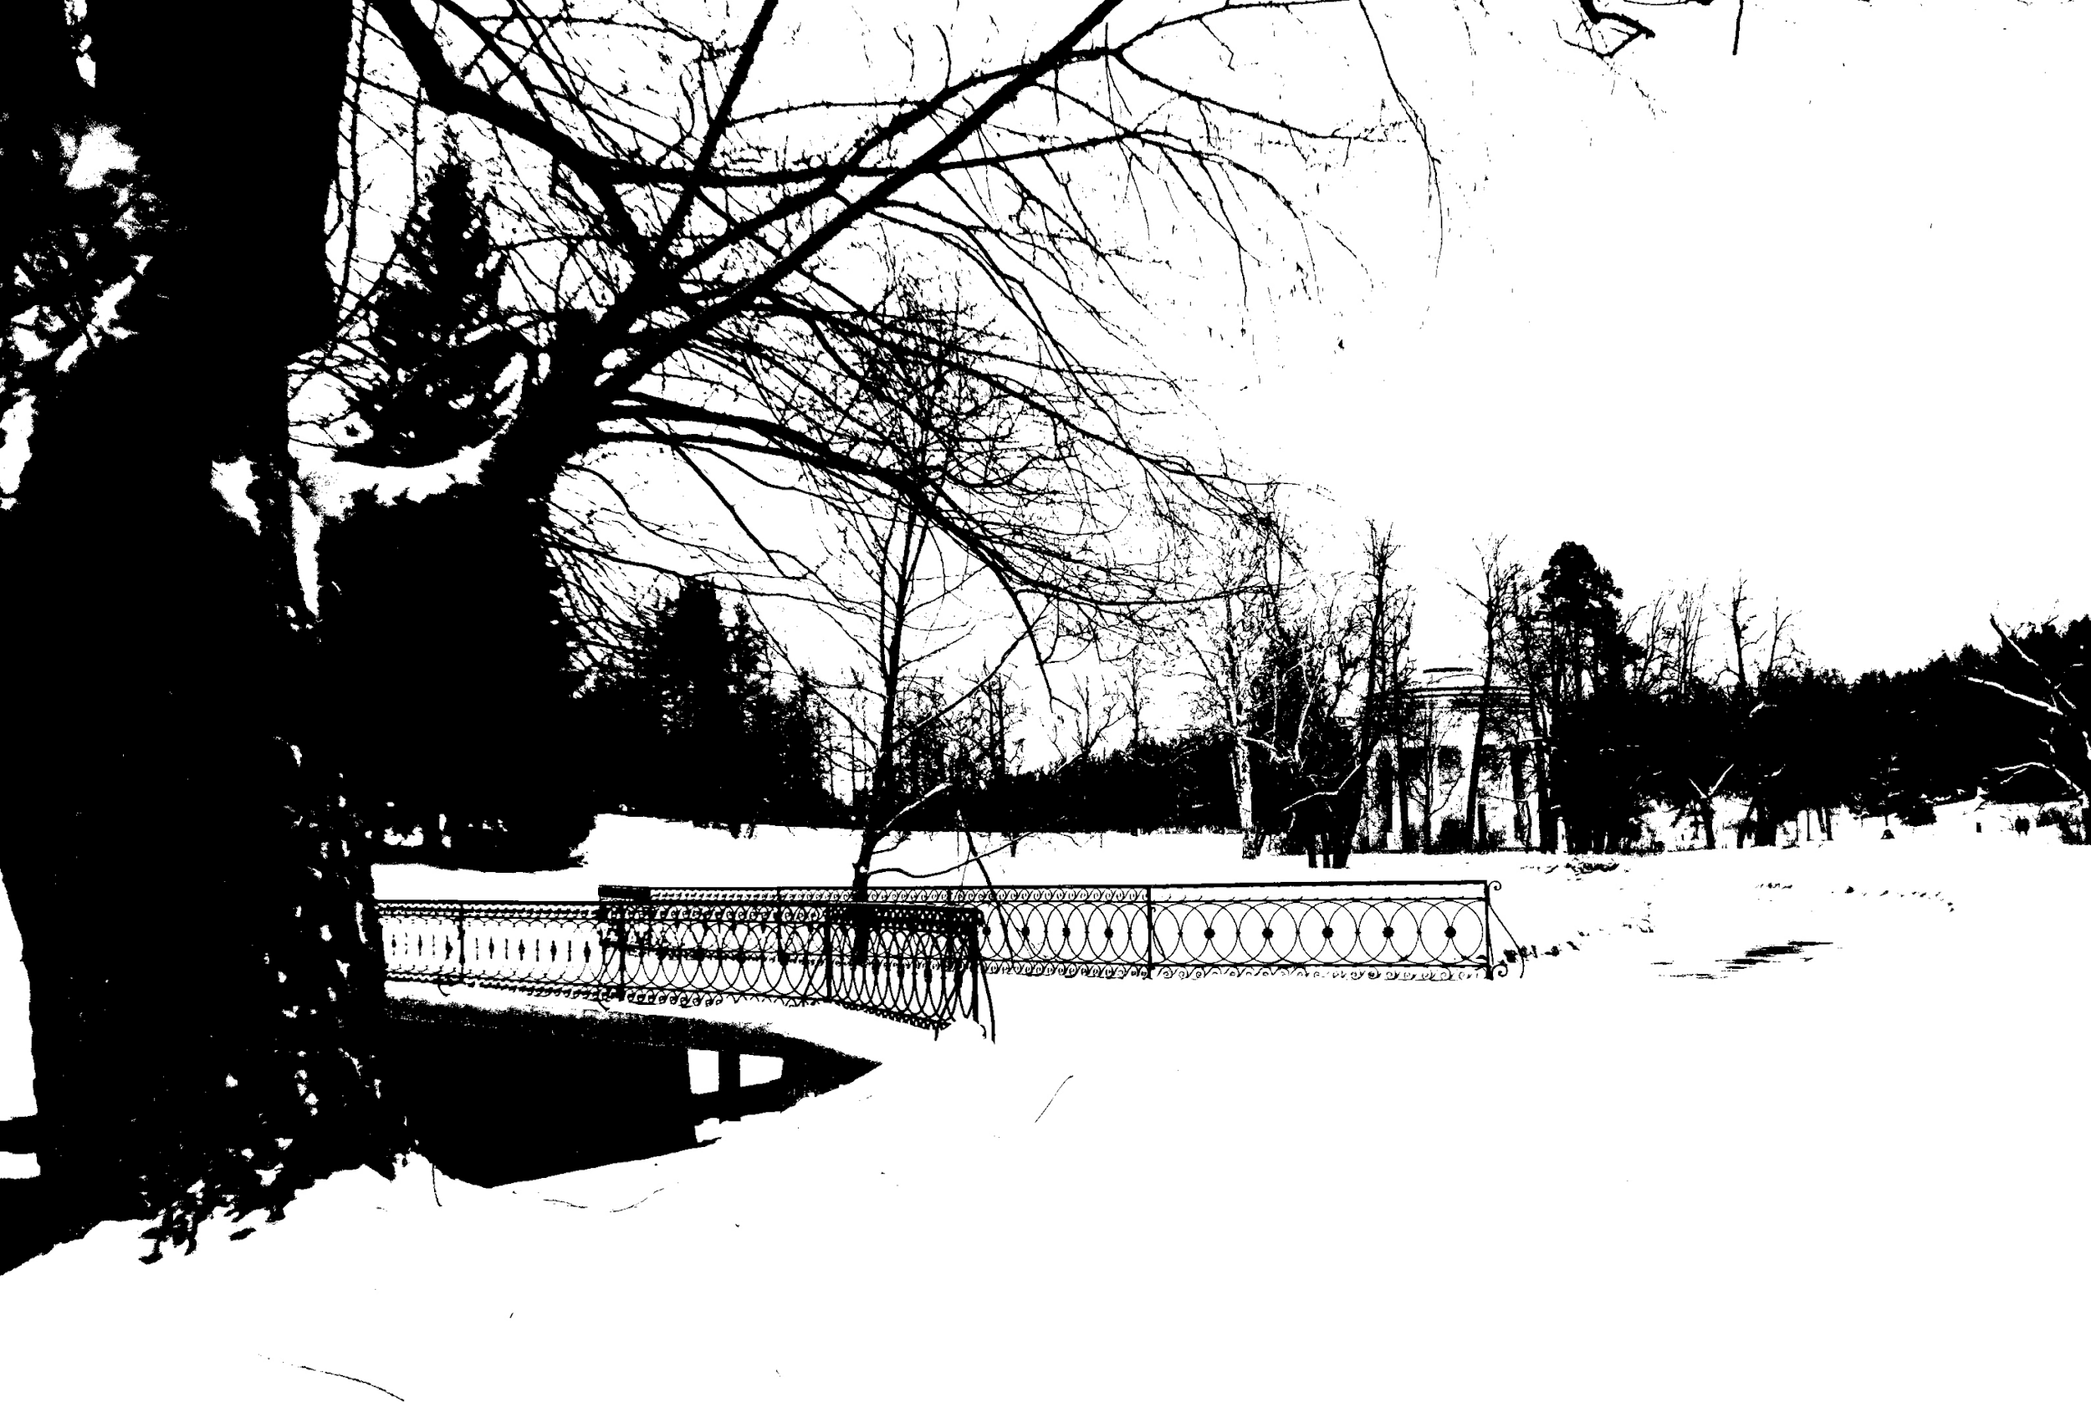
Original Image and Example of Threshold Effect Used on Image

Slide 11
Arithmetical Operations on Images

Slide 12
Image Arithmetic
Implementation of standard arithmetic operations on images – examples:
Addition
Subtraction
Multiplication
Division
Having many uses in image processing:
Preliminary step in more complex operations
By itself
Example: image subtraction to be used to detect differences between 2+ images of same scene/object

Slide 13
Image Addition
Adding
2 images, or
constant to an image
Adding:
each element in the 1st image matrix, with
a corresponding element in the 2nd image matrix
Returning a sum of corresponding elements to the 3rd, output image matrix
Image matrices – real, non-sparse numeric matrices with the same size

Slide 14
Image Subtraction
Subtracting
1 image from another, or
a constant from an image
Subtracting:
each element in the 1st image matrix, from
a corresponding element in the 2nd image matrix
Returning a sum of corresponding elements to the 3rd, output image matrix
Image matrices – real, non-sparse numeric matrices with the same size

Slide 15
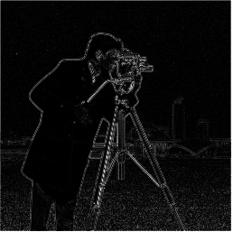
Image Absolute Difference
Absolute difference of 2 images
Subtracting:
each element in the 1st image matrix, from
a corresponding element in the 2nd image matrix
Returning an absolute difference of corresponding elements to the 3rd, output image matrix
Notes:
Image in the RHS shows a difference between two images. The difference may have several sources: (i) the second image represents a scene later in time or (ii) the second image is a compressed version of the origina.

Slide 16
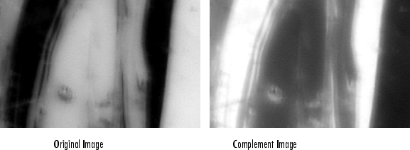
Image Complementation
Complementing an image
Computing complement of the image matrix
Image matrix can be:
a binary image
a grayscale image
a true-colour (RGB) image
Output has the same size as the input

Slide 17
Image Multiplication
Multiplying:
2 images, or
an image by a constant
Multiplying each element in the 1st image matrix by a corresponding element in the 2nd image matrix - not like matrices multiplication from algebra classes
Returning corresponding elements to the 3rd, output image matrix
Image matrices – real, non-sparse numeric matrices with the same size

Slide 18
Image Division
Dividing:
1 image by another, or
an image by a constant
Dividing each element in the 1st image matrix by a corresponding element in the 2nd image matrix - is there a corresponding algebraic operation?
Returning corresponding elements to the 3rd, output image matrix
Image matrices – real, non-sparse numeric matrices with the same size

Slide 19
Linear Combination of Images
where:
A_{out} - the output image
k₁...k_{n} - weights of each image,
A₁...A_{n} - image matrices,
k₀ - bias term (constant shift).
Output has the same size as input
Mind the notation!
Notes:
Pay attention to the notation. Scalars are shown by lower case letters. Matrices are shown by capital letters.

Slide 20
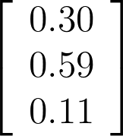
Weighting Matrix
Weighting Matrix
[10, 7, 72]
X
15.05
Notes:
Can you guess what this does?

Slide 21
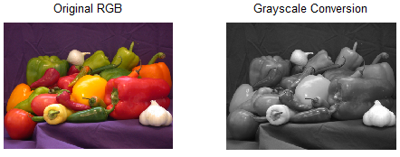
Weighting Matrix cont.
Linear combination of colour channels
Computing linear combination of:
Rows of weighting matrix, with
Colour channels of image matrix
Possibly adding corresponding constant value to each combination
Output data size – same as input data size

Slide 22
Image Averaging (Smoothing)
Creating an approximating function:
Attempting to capture important patterns in data, while
Leaving out:
Noise, or
Other fine-scale structures/rapid phenomena
Pixels modified so:
Isolated pixels (presumably because of noise) reduced, and
Pixels slightly darker (or brighter) than adjacent pixels made brighter (or darker) leading to a smoother image
Notes:
“Isolated” here means the pixel with a given intensity value does not have neighbours with similar intensity values.

Slide 23
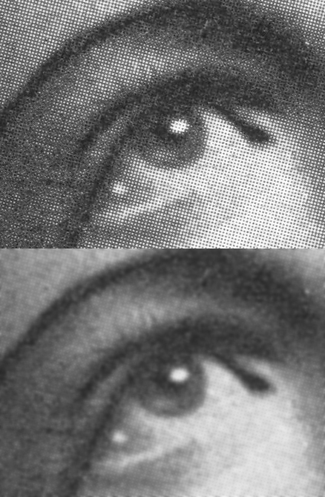
Weighted Sum/Convolution
A digital counterpart of the mathematical operation (that you have learned during the Signals Theory course)
An input image is convolved with a kernel
Application: blurring
Example: Gaussian blur used in order to obtain a smoother grayscale digital image of halftone print
Notes:
More on the topic during classes about digital image filters

Slide 24
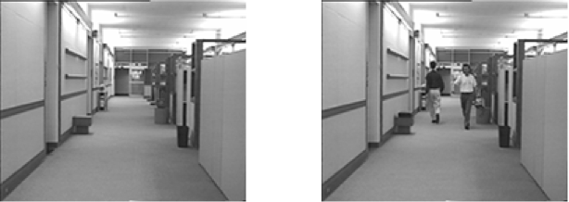
Basics of Background Modelling (Subtraction) / Foreground Detection
Technique extracting image foreground for further processing (object recognition etc.)
One of the major image processing/computer vision tasks aiming at detection of changes in an image sequence
“Background foreground” by Hgallego – Own work. Licensed under CC BY-SA 3.0 via Commons – https://commons.wikimedia.org/wiki/File:Background_foreground.tiff#/media/File:Background_foreground.tiff

Slide 25
Thank You for Your Attention!

